Slide 1
Cascading Style Sheet (CSS)

Slide 2
What is CSS?
CSS stands for Cascading Style Sheets
Styles define how to display HTML elements
Styles are normally stored in Style Sheets
Styles were added to HTML 4.0 to solve a problem
External style sheets can save a lot of work
External style sheets are stored in CSS files
Multiple style definitions will cascade into one
CSS Saves a Lot of Work!
CSS defines HOW HTML elements are to be displayed.
Styles are normally saved in external .css files. External style sheets enable you to change the appearance and layout of all the pages in a Web site, just by editing one single file!

Slide 3
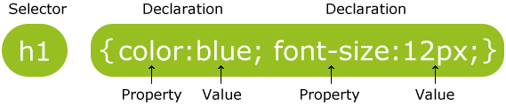
CSS Syntax
A CSS rule has two main parts: a selector, and one or more declarations:
The selector is normally the HTML element you want to style.
Each declaration consists of a property and a value.
The property is the style attribute you want to change. Each property has a value.

Slide 4
CSS Selectors
Three types of CSS Selectors
Element
Class
ID
CSS Element Selector Example:
A CSS declaration always ends with a semicolon, and declaration groups are surrounded by curly brackets:
p {color:red;text-align:center;}
To make the CSS more readable, you can put one declaration on each line, like this:
p {
color:red;
text-align:center;
}

Slide 5
CSS Style Rule
p {
font-size: x-large ;
background-color: yellow
}
property names
declarations
selector string
declaration block

Slide 6
CSS Comments
Comments are used to explain your code, and may help you when you edit the source code at a later date. Comments are ignored by browsers.
A CSS comment begins with "/*", and ends with "*/", like this:
/*This is a comment*/
p
{
text-align:center;
/*This is another comment*/ color:black;
font-family:arial;
}

Slide 7
Element Type Selectors
An element type selector matches all instance of the element in the document with the corresponding element type name. Let's try out an example to see how it actually works:
Example p
{
color: blue;
}

Slide 8
The id Selector
The id selector is used to specify a style for a single, unique element.
The id selector uses the id attribute of the HTML element and is defined with a "#".
Example
Imagine within the body element of our html page, we have the following paragraph element
<p id=”welcome”>Welcome to the wonderful world of HTML</p>
We can then create a CSS rule with the id selector:
#welcome
{
text-align:center;
color:red;
}

Slide 9
The class Selector
The class selector is used to specify a style for a group of elements. Unlike the id selector, the class selector is most often used on several elements.
This allows you to set a particular style for many HTML elements with the same class.
The class selector uses the HTML class attribute, and is defined with a "."
In the example below, all HTML elements with class="center" will be center-aligned:
Example
Imagine within the body element of our html page, we have the following header element
<h2 class=”center”>Summary</h2>
We can then create a CSS rule with the class selector:
.center
{
text-align:center;
}

Slide 10
Difference between ID and Class
ID's are unique
Each element can have only one ID
Each page can have only one element with that ID
Classes are NOT unique
You can use the same class on multiple elements.
You can use multiple classes on the same eleme

Slide 11
Difference between ID and Class
Key | Id | Class
Syntax | In CSS for an element ID name starts with the “#” symbol followed by a unique name assigned to it. | On the other hand class assigned to an element has its name starts with “.” followed by class name.
Selector | Only one ID selector can be attached to an element. | Multiple class selectors can be attached to an element.
Uniqueness | Id is unique in a page and can only apply to at most one element Each element can have only one ID | The class can be applied to multiple elements so it could be multiple times on a single page. You can use the same class on multiple elements.

Slide 12
Three Ways to Insert CSS
There are three ways of inserting a style sheet:
External style sheet
Internal style sheet
Inline style

Slide 13
Inline Styles
An inline style loses many of the advantages of style sheets by mixing content with presentation. Use this method sparingly!
To use inline styles you use the style attribute in the relevant tag. The style attribute can contain any CSS property. The example shows how to change the color and the left margin of a paragraph:
<p style="color:red;margin-left:20px">This is a paragraph.</p>

Slide 14
Internal Style Sheet
An internal style sheet should be used when a single document has a unique style. You define internal styles in the head section of an HTML page, by using the <style> tag, like this:
<head>
<style type="text/css">
hr
{
color:blue;
}
p
{
margin-left:20px;
}
body
{
background-image:url("images/back40.gif");
}
</style>
</head>
<body>
</body>

Slide 15
External Style Sheet
An external style sheet is ideal when the style is applied to many pages.
With an external style sheet, you can change the look of an entire Web site by changing one file.
Each page must link to the style sheet using the <link> tag.
The <link> tag goes inside the head section:

Slide 16
<head>
<link rel="stylesheet" type="text/css" href="mystyle.css" />
</head>
An external style sheet can be written in any text editor. The file should not contain any html tags. Your style sheet should be saved with a .css extension. An example of a style sheet file is shown below:
hr {color:red;}
P {argin-left:20px;}
body {background-image:url("images/back40.gif");}

Slide 17
CSS Background Properties
CSS background properties are used to define the background effects of an element.
CSS properties used for background effects:
background-color
background-image
background-repeat
background-attachment
background-position

Slide 18
Background Color :
The background-color property specifies the background color of an element.
The background color of a page is defined in the body selector:
Example
body {background-color:#b0c4de;}
In the example below, the h1, p, and div elements have different background colors:
Example
h1{background-color:#6495ed;}
p{background-color:#e0ffff;}
div{background-color:#b0c4de;}

Slide 19
Background Image
The background-image property specifies an image to use as the background of an element.
By default, the image is repeated so it covers the entire element.
The background image for a page can be set like this:
Example
body {background-image:url('paper.gif');}
Background Image - Repeat Horizontally or Vertically
By default, the background-image property repeats an image both horizontally and vertically.
Some images should be repeated only horizontally or vertically, or they will look strange.
To repeat an image only horizontally or vertically, use the background-repeat property.
body { background-image:url('gradient2.png');
background-repeat:repeat-x; }

Slide 20
Background Image – Set no-repeat
When using a background image, use an image that does not disturb the text.
Showing the image only once is specified by the background-repeat property:
Example
Body
{
backgroundimage:url('img_tree.png');
background-repeat:no-repeat;
}

Slide 21
CSS background-attachment
The background-attachment property is used to specify if the background image is fixed or scroll with the rest of the page in browser window.
If you set fixed the background image then the image will not move during scrolling in the browser.
example with fixed background image.
background: white url('bbb.gif');
background-repeat: no-repeat;
background-attachment: fixed;

Slide 22
CSS background-position
The background-position property is used to define the initial position of the background image. By default, the background image is placed on the top-left of the webpage.
You can set the following positions:
center
top
bottom
left
Right
Example:
background-position: center;

Slide 23
Background - Shorthand property
The shorthand property for background is simply "background":
Example
Body
{
background:#ffffff url('img_tree.png') no-repeat right top;
}
When using the shorthand property the order of the property values are:
background-color
background-image
background-repeat
background-attachment
background-position

Slide 24
CSS Border
The CSS border is a shorthand property used to set the border on an element.
The CSS border properties are use to specify the style, color and size of the border of an element. The CSS border properties are given below
border-style
border-color
border-width
border-radius

Slide 25
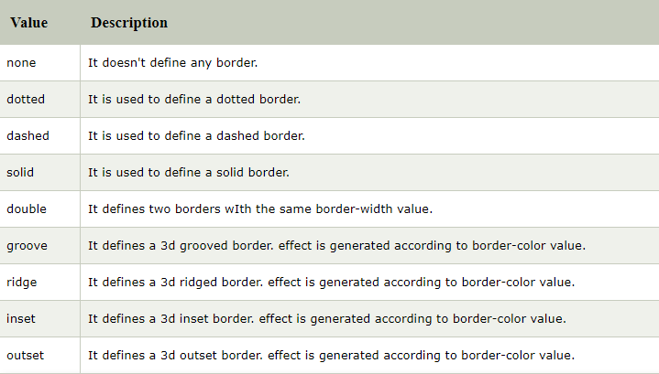
CSS border-style
The Border style property is used to specify the border type which you want to display on the web page.

Slide 26
CSS border-width
The border-width property is used to set the border's width.
It is set in pixels.
You can also use the one of the three pre-defined values, thin, medium or thick to set the width of the border.
border-width: 5px;
border-width: medium;

Slide 27
CSS border-color
There are three methods to set the color of the border.
Name: It specifies the color name. For example: "red".
RGB: It specifies the RGB value of the color. For example: "rgb(255,0,0)".
Hex: It specifies the hex value of the color. For example: "#ff0000".
Ex. border-color: #98bf21;

Slide 28
CSS Margin
CSS Margin property is used to define the space around elements.
It clears an area around the element.
Top, bottom, left and right margin can be changed independently using separate properties.
margin-top
margin-right
margin-bottom
margin-left
You can also change all properties at once by using shorthand margin property.
margin: 10px 5px 15px 20px;

Slide 29
If the margin property has four values:
margin: 10px 5px 15px 20px;
top margin is 10px
right margin is 5px
bottom margin is 15px
left margin is 20px
If the margin property has three values:
margin: 10px 5px 15px;
top margin is 10px
right and left margins are 5px
bottom margin is 15px
If the margin property has two values:
margin: 10px 5px;
top and bottom margins are 10px
right and left margins are 5px
If the margin property has one value:
margin: 10px;
all four margins are 10px
Note: Negative values are allowed.

